Slide 1

By: Vaibhav Chaudhari 2017B5A70834G
Finding Properties of Galaxy using the Dark Matter Halos with Machine Learning

Slide 2
Machine Learning in Astrophysics
Rapid Growth in Data Size and Complexity
Analyze complex patterns and get meaningful results
Here used to predict the properties of Galaxy
Techniques like Random Forest, Support Vector Machines, Stochastic Gradient Descent and Neural Networks used
Dimensionality Reduction and Feature Selection Done using PCA

Slide 3
Origin of Dark Matter
Visible matter makes 5% of mass of the universe
Galaxies cannot account for their shapes, movements and distribution

Slide 4
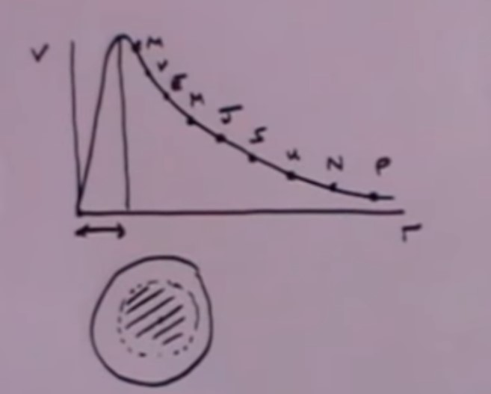
This confirms the presence of Dark Matter

Slide 5
Aim of the Project
Understand the Important role of Dark Matter in the Universe
Use Machine Learning Techniques to extract relevant information about galaxies
The results also help in confirming the accuracy of Data we have collected

Slide 6
Dark Matter
Two suggested explanations for discrepancies between luminous mass and conventional dynamic mass of galaxies:
Dark Matter Halo Model
MOND Model

Slide 7
Machine Learning
Dataset in the HDF5 format.

Slide 8
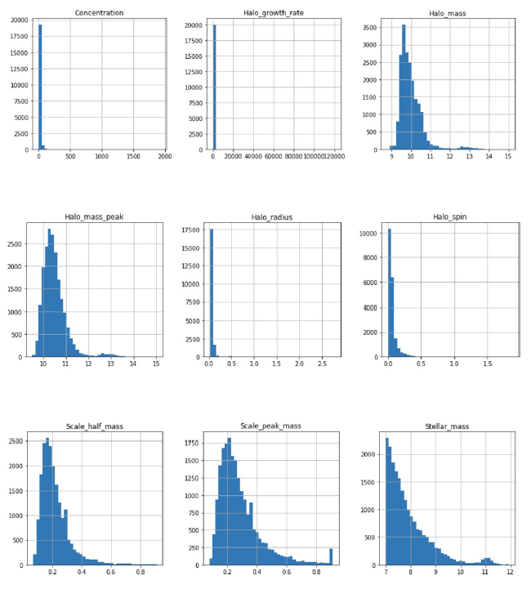
Features and Correlation
Feature Scaling is done on the basis of the visual inspection of these histograms

Slide 9
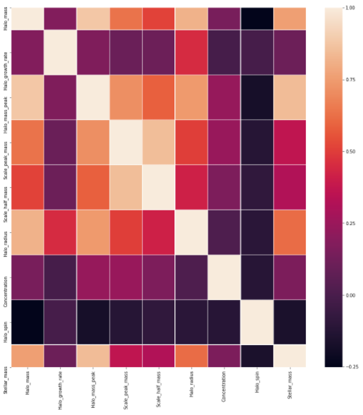
Feature Scaling
Normalize the range of independent variables or features of data
It is known as Data Normalization and is done during Pre-processing
Two types of Scaling used:
MinMax Scaling
Standard Scaling

Slide 10
Pipelines
A machine learning pipeline is used to help automate machine learning workflows.
They operate by enabling a sequence of data to be transformed and correlated together in a model
A well-organised pipeline makes the implementation more flexible
Overfitting is a modeling error that occurs when a function is too closely fit to a limited set of data points.
Overfitting the model generally takes the form of making an overly complex model to explain idiosyncrasies in the data under study.

Slide 11
Random Forest
Rather than utilize the predictions of one decision tree, the algorithm will take the ensemble results of an outsized number of decision trees

Slide 12
Support Vector Machines (SVM)
SVMs are a type of classifier that works by finding the hyperplane in feature space that best separates classes
SVM generates optimal hyperplanes in an iterative manner, which minimizes error.
Support vectors are the data points, closest to the hyperplane.

Slide 13
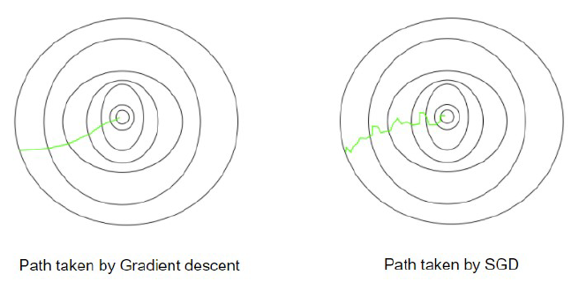
Stochastic Gradient Descent (SGD)
Gradient means the slope of a function, which measures the degree of change of a variable with respect to the changes of another variable
Gradient descent is run iteratively to find the optimal values of the parameters such that they can minimize the cost.
Three types of Gradient Descent:
Batch Gradient Descent
Stochastic Gradient Descent
Mini-batch Gradient Descent

Slide 14
Multilayer Perceptron
A feedforward Artificial Neural Network (ANN)
Consists of a minimum of three layers of nodes: an input layer, a hidden layer and an output layer.
Aside from the input nodes, each node could be a neuron that uses a nonlinear activation function.
Utilizes a supervised learning technique called backpropagation for training.
It can distinguish data that's not linearly separable.

Slide 15
Cross-Validation for Machine Learning Algorithms
Cross-validation is a resampling procedure used to evaluate machine learning models on a limited data sample.
This has been done to prevent overfitting in the model

Slide 16
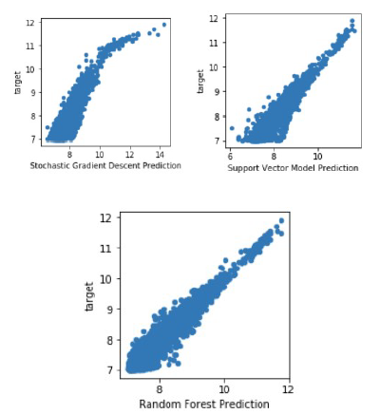

Slide 17
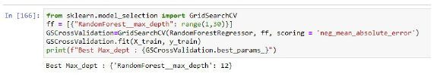
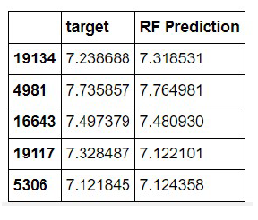
Hyperparameter Search and Exaluation
Different parameters for every model
GridSearch runs the model runs the model for each and every parameter and tells us the parameter which is optimum

Slide 18
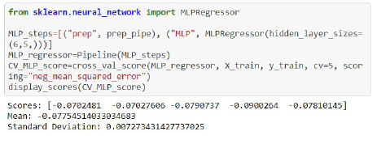
Cross-Validation for MLP

Slide 19
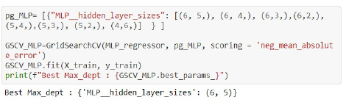
Hyperparameter Tuning for MLP
We use the GridSearch library for finding the best number of hidden layers in the neural network so that our neural network can work efficiently

Slide 20
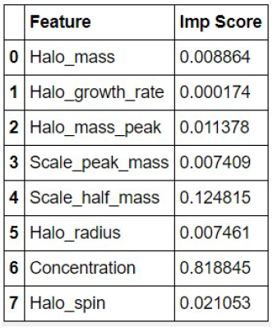
Feature Selection and Dimensionality Reduction
Dimensionality Reduction is reducing the dimension of the feature space to handle the data more easily.
The features have been selected on the basis of the importance of each and every feature.
We can conclude that the concentration, scale_half_mass
and the Halo_spin are the most important features.

